Slide 1

#LifeKoKaroLift
Android

Slide 2


Course : Android
Lecture On : Menus & Material Design
Instructor : Rohit Jain

Slide 3
In the last class we covered…
Material Design
ToolBar & Menus
Dialog Box
Navigation Drawer

Slide 4
Today’s Agenda
ViewPager
Notification
Services

Slide 5
Demo Navigation Drawer

Slide 6
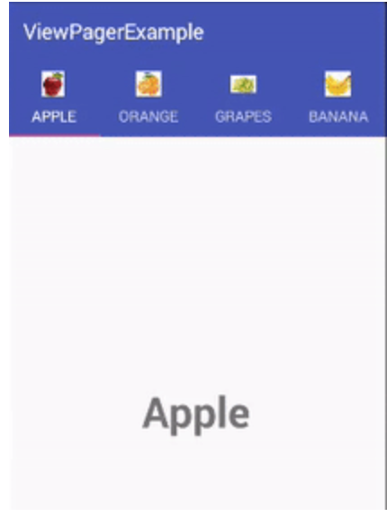
ViewPager
Layout that allows the user to swipe left and right through "pages" of content which are usually different fragments. This is a common navigation mode

Slide 7
Building a Whatsapp Viewpager
Add a TabLayout
Add a ViewPager
Define Fragments

Slide 8
Demo ViewPager

Slide 9
Notifications
A notification is a message you can display to the user outside of your application's normal UI. Notifications appear in the phone's notification area and then can be expanded to see more information.
This is typically used to keep the user informed about events that are coming in that they should be aware of such as new email messages, new chat messages or an upcoming calendar event.
Notifications can include actions that let the user take a relevant action from within the notification drawer. At the minimum, all notifications consist of a base layout including:
Icon of the app or relevant user image
Title and message
Timestamp

Slide 10
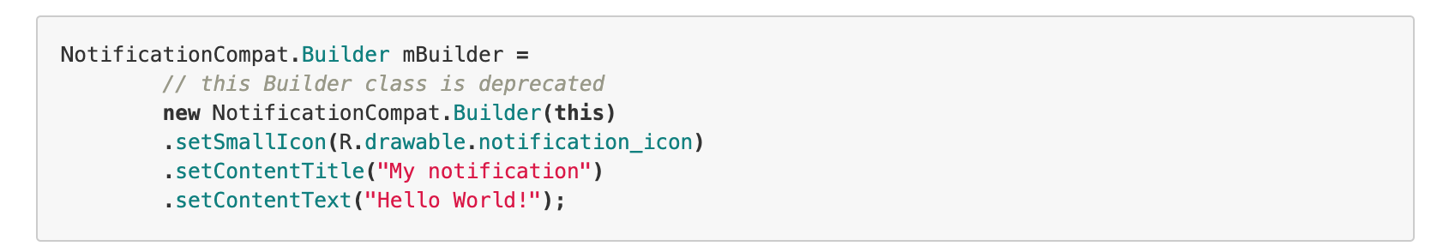
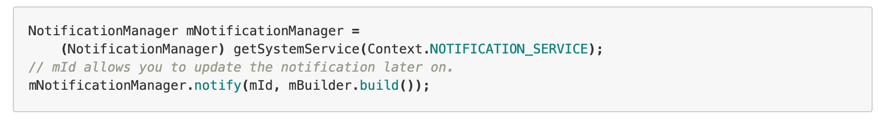
Creating a Notification
Let's build a basic notification using the NotificationCompat.Builder. Typically this will contain at least an icon, a title, body

Slide 11
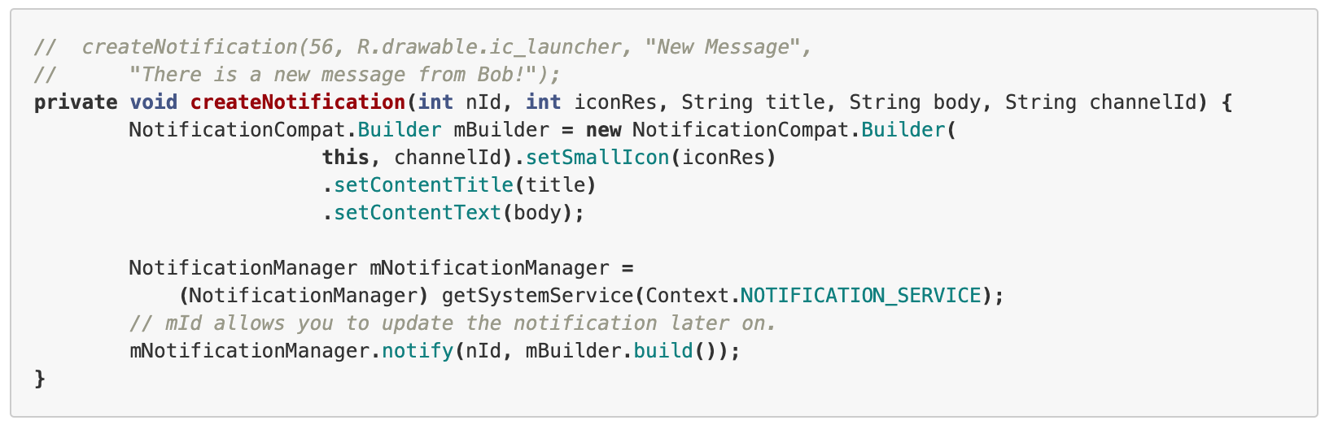
Generic Method for Calling a notification

Slide 12
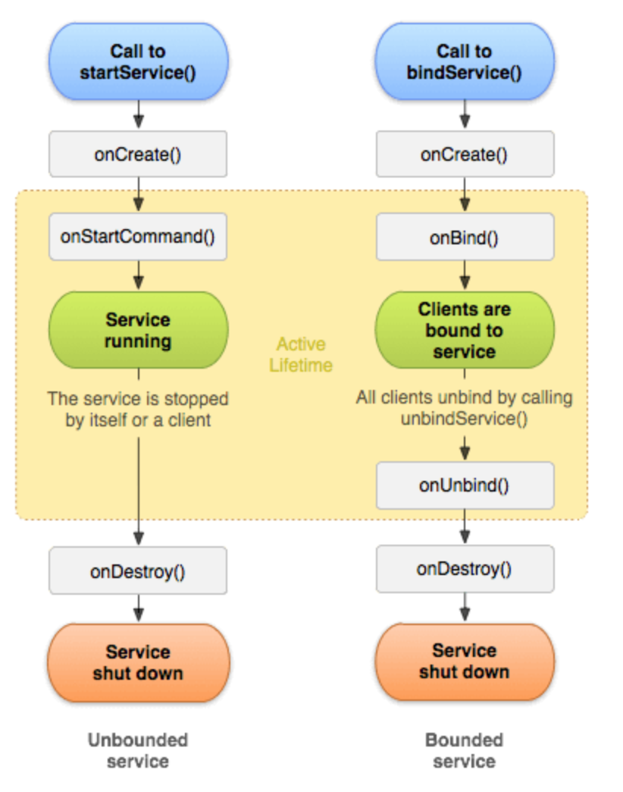
Service
Android service is a component that is used to perform operations on the background such as playing music, handle network transactions, interacting content providers etc. It doesn't has any UI (user interface).

Slide 13
Demo Service

Slide 14
Broadcast Receiver
Broadcast Receivers simply respond to broadcast messages from other applications or from the system itself. These messages are sometime called events or intents. For example, applications can also initiate broadcasts to let other applications know that some data has been downloaded to the device and is available for them to use, so this is broadcast receiver who will intercept this communication and will initiate appropriate action.

Slide 15
Demo Broadcast Receiver

Slide 16
#LifeKoKaroLift
Thank You!

